Slide 1
NO LIMITS: EXPAND YOUR PRACTICE BY ADDING ONLINE MEDIATION
SCMA 30th ANNUAL CONFERENCE
November 3, 2018
Los Angeles, CA

Slide 2
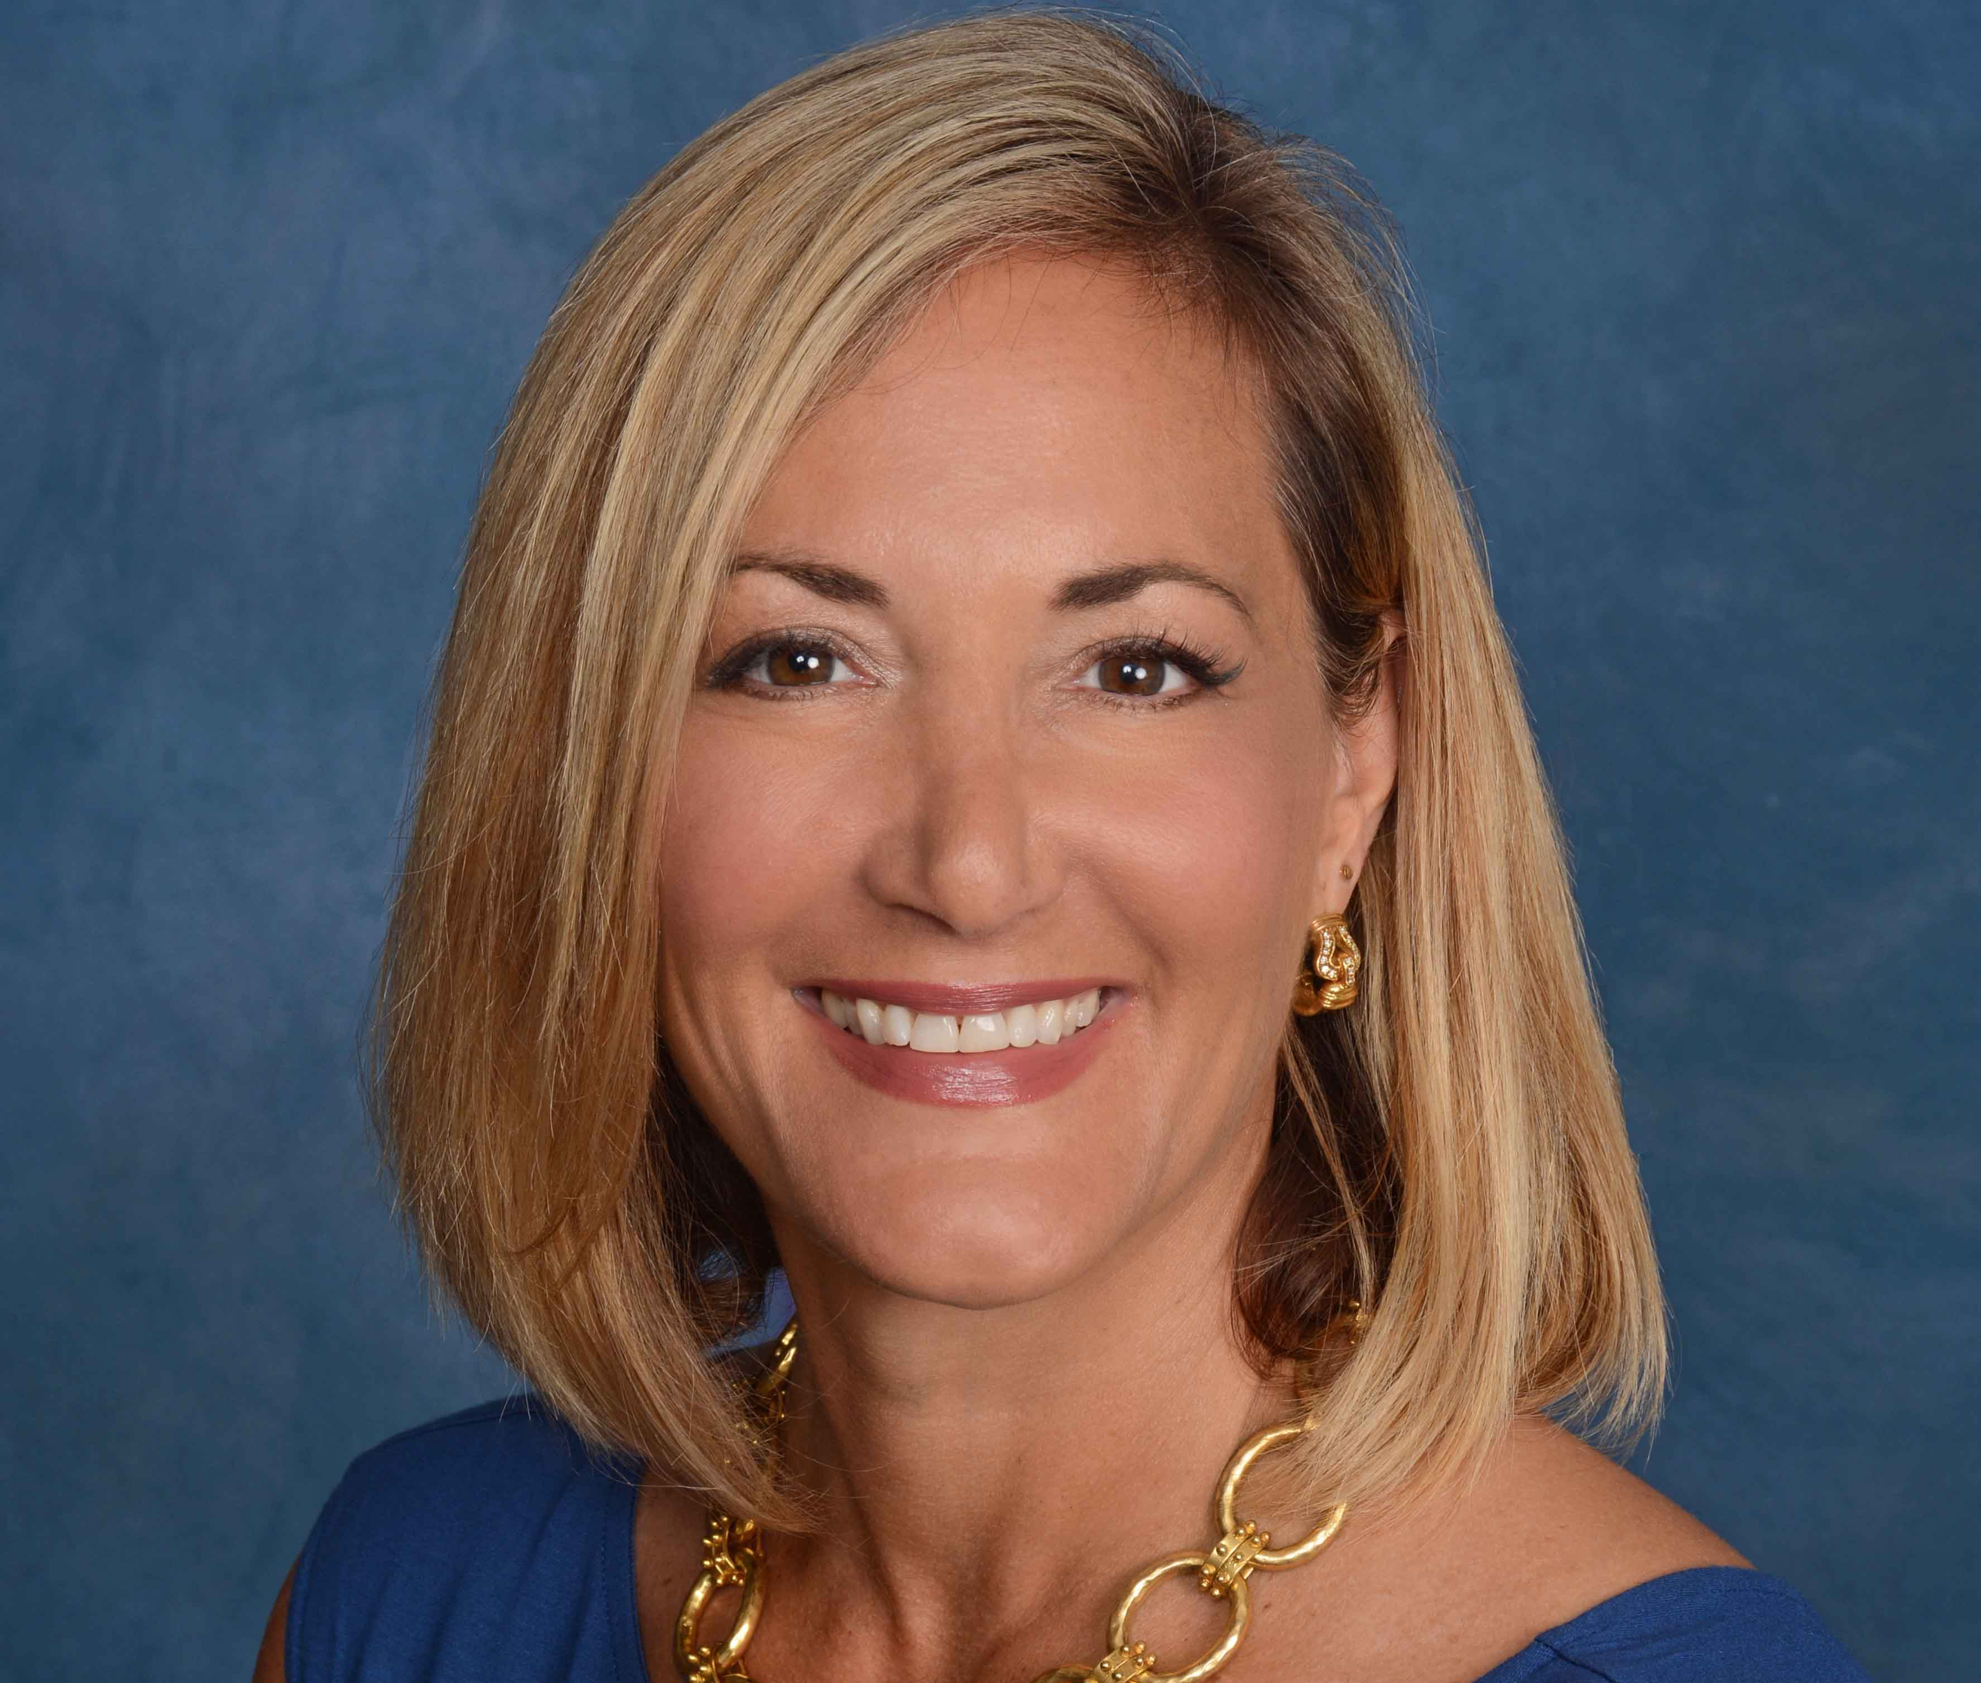
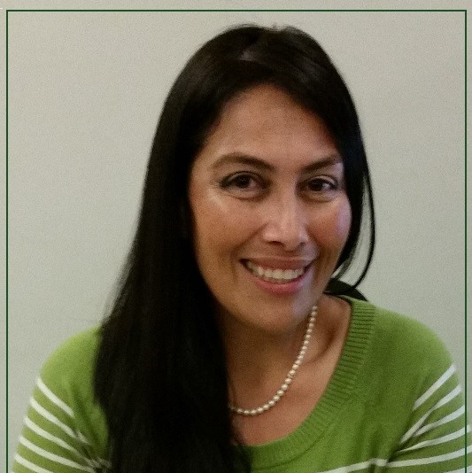
Workshop Panelists
Susan Guthrie, Esq. – Family Law Attorney and Mediator for almost 30 years. Co-Founder of Breaking Free Mediation providing mindful dispute resolution services online and in person. Trains fellow professionals in ODR best practices and practical application through her company Learn to Mediate Online.
Maritza Gutierrez –Program Manager and Supervising Mediator with the Los Angeles County Department of Consumer and Business Affairs (DCBA). DCBA began their Online Dispute Resolution (ODR) Program in 2014 to provide the community with both traditional and ODR mediation practices.
Adya Riss, MSW – Mediator and Supervisor with the Ventura Center for Dispute Settlement (VCDS) and a co-parent professional for coParenter.com providing on-demand online dispute resolution and coaching for divorced, separated, and never-married parents.
Notes:
3 minutes total

Slide 3
ONLINE MEDIATION FORMATS
Video Conferencing – Zoom, Skype, GotoMeeting, etc.
Online Messaging
and/or Email
Within an App such as coParenter, On Demand
Notes:
Adya to review, intro Jonathan Verk and coParenter (1-2 minutes)

Slide 4
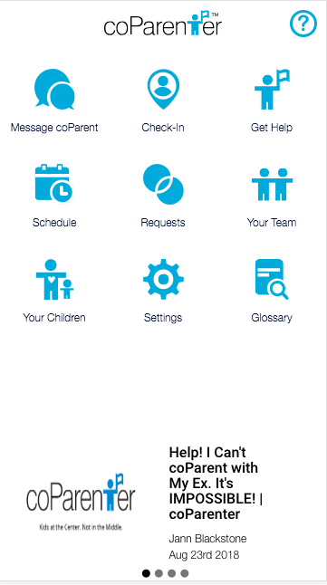
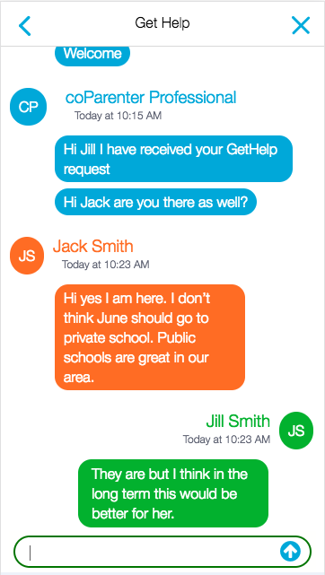
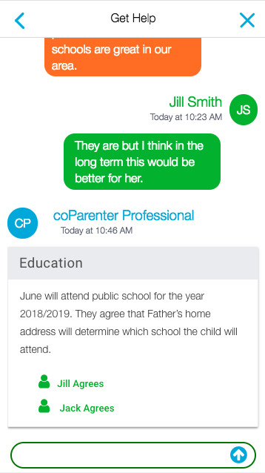
Notes:
Adya – 3 minute

Slide 5
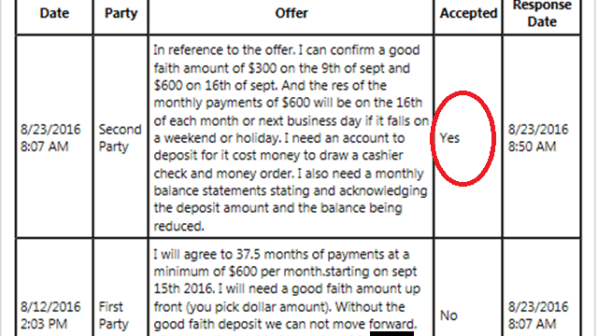
Back and Forth Bidding
Ebay Style
Notes:
Maritza – 2.5 minutes

Slide 6
Portal Messaging
Notes:
Maritza – 2.5 minutes

Slide 7
Demonstration Video Divorce Mediation via Zoom
(Video Inserted Here)
Notes:
Susan – 10-11 minutes

Slide 8
ADVANTAGES & DISADVANTAGES OF ONLINE MEDIATION
PROS CONS
Convenient
Separation
Privacy / Comfort
Accessibility
Inexpensive
It’s Different
Tech Fear
Less Personal
Security Issues
Notes:
Adya – Pros / Susan - Cons - 5 minutes

Slide 9
Innovative or Expected?
Millennials
Online/Video Meetings in the Workplace
Relationships and Communications via Skype, Facetime, Text and Snapchat
Notes:
Maritza to lead off – 1-2 minutes

Slide 10
THREE KEYS TO SUCCESS
MEDIATOR PREPARATION AND FLEXIBLE MINDSET
CLIENT EDUCATION
ESTABLISHING AND FOLLOWING “BEST PRACTICES”
Notes:
Adya

Slide 11
TECH ISSUES AND CHOICE OF PROGRAMS
Confidential and Secure – Encrypted, Password Protected and Secure WIFI Network
Facilitates the Process – Sufficient Participants, Screen Sharing, Party Mute for Caucus and “Waiting Room”
Accessory Programs Needed such as Secure Document Transmission (ex: Dropbox), Document Execution (ex: Docusign), Form Completion (ex: Separate.pro)
Notes:
Susan to lead off – 3-4 minutes point out relevant section on the Ground Rules, Reference the video

Slide 12
CONFIDENTIALITY & PRIVACY PROTECTION
Issues in Every Mediation but now the Client Environment is out of your control
Client Education and Guidelines are Imperative – Clients need to be educated on the risks and legal ramifications and rules of conduct established
Notes:
Maritza – Emphasis on Client Environment Control - Reference Handout -

Slide 13
MEDIATION CONFIDENTIALITY
California Law – Evidence Code 1119 Mediation Privilege
Dissemination to Third Parties can Waive the Privilege
Risks in Online Mediation
Unintended Third Parties
Recording of Sessions
Notes:
Susan first two example of inadvertent third party. Maritza story about printing out screen to take to court – bottom of screen it says that information is “Confidential” Adya has “confidentiality blurb” as well.

Slide 14
PRIVACY
Mediation is a Private Process – Major Benefit of the Process
Beyond Confidentiality – Privacy is Inherent to the Process - Breach of Trust to Include Unauthorized or Undisclosed Third Parties
Written Explanation and Rules – For Client’s Protection and to Maintain the Integrity of the Mediation Process
Notes:
Adya – explain why privacy is a major benefit – Susan tell story about girlfriend in room – Ground Rules

Slide 15
MEDIATOR PREPARATION
Familiarization with programs and technology is key
Make Sure You Have all the Programs that You Need and that they Function Well for your Purposes
Streamline Your Processes and Procedures – Forms Help!
Prepare Educational Documents for Clients and/or Participate in Client Preparation
Notes:
Adya – First and second slides and Martiza – Third and Fourth slides – forms to clients by email which must be filled out and returned BEFORE the first mediation – 4 minutes

Slide 16
The Mediator has to be ready for disruptions, glitches and the unexpected as in any mediation. It helps to go with the flow.
The clients don’t know that whatever is happening is not “normal” unless you tell them!
Flexible Mindset
Notes:
Adya – 1 minute

Slide 17
PRACTICE TIPS FOR A SMOOTH PROCESS
Set Expectations to Minimize Interruptions and Distractions:
Interruption Free Zone -
Request Client take Reasonable Measures to Insure not Interrupted, Child Care, Notice to Co-Workers, etc.
Technology Hiatus –
No Web Surfing, Checking Emails, Texting or Other Use of Technology During Sessions
Notes:
Susan – reference the Ground Rules

Slide 18
AVOID TECHNOLOGY ISSUES
Familiarization with Platform in Advance
Practice Session
Early Log-On for Sessions
Technology Failure Protocol
Caucus Failure
Notes:
Adya – tutorials to be included in new version, Susan – practice session, Maritza – Early log on – video demonstration, Susan – last two

Slide 19
ONLINE MEDIATION
Expand your Client Base, Availability and INCOME
Clients Will Increasingly Expect to Conduct Their Mediation Online
Convenient for Mediator and Clients – Mobility, Accessibility, Efficiency and Convenience
Disadvantages Can Be Effectively Minimized or Eliminated with Proper Preparation and Client Education
Use Your Online Mediation Ground Rules and Guidelines
Final Tip: LET PEOPLE KNOW YOU OFFER ODR - ADD IT TO YOUR WEBSITE!!!
Notes:
Maritza – Statistics – all three will discuss – Susan to end with add to website story.

Slide 20
CONTACT INFORMATION
Maritza Gutierrez
mediation@dcba.lacounty.gov
https://dcba.lacounty.gov
Adya Riss
adya@coparenter.org
www.coparenter.com
Susan Guthrie, Esq.
susan@breakingfreemediation.com
www.breakingfreemediation.com
www.learntomediateonline.com
Notes:
Please complete your surveys – we’d love the feedback!

