Slide 1
SCMA
31st Annual Fall Conference
Los Angeles, California
November 1-2, 2019
Los Angeles Grand Hotel
21st CENTURY MEDIATORS--
TAKE YOUR PRACTICE TO THE NEXT LEVEL
Moderator: Harold Coleman
Panelist: Dr. Debra Dupree
Panelist: Gregg F. Relyea

Slide 3
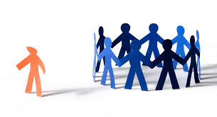
The POWER of CONNECTIONS
Of these 7 techniques, what has worked best for you…what hasn’t?
Identify 2 techniques you use to build rapport with parties.
What would you like to improve upon in your mediation techniques?
3 QUESTIONS, 3 PEOPLE, 2 MINUTES EACH

Slide 4
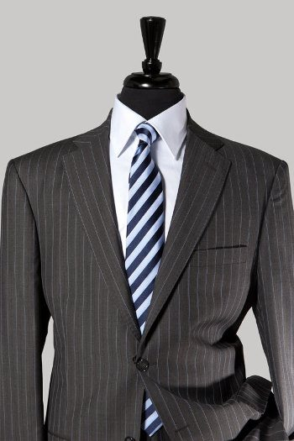
The Wall of Pinstripes
Pressing or Directive Actions

Slide 5
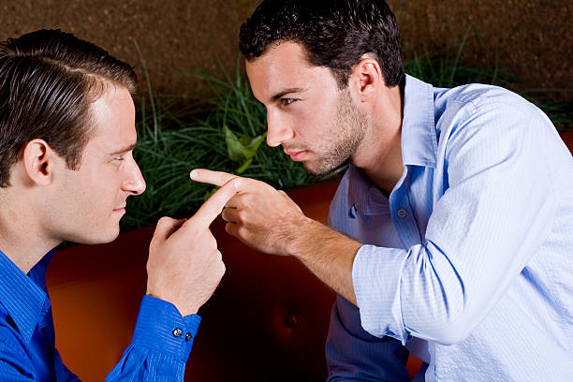
Addressing Emotions, Relationships, Hostility
Ask what brought them together
Ask about the early days--when they were getting along
Help the parties remember the good times and what each party contributed

Slide 6
Parties are a Brilliant Resource
Uncovering Parties’ Suggestions or Solutions

Slide 7
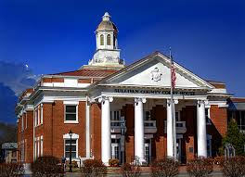
Addressing Beliefs to Uncover Alternative Solutions
Spiritual Values
Man-Made Judicial System
Bring alive the risks of non-agreement with storytelling

Slide 8
THE LIMITATIONS OF BINARY THINKING
Between fight and flight, win and lose, right and wrong, yes or no, and us versus them,
There is an infinite space,
Meaningful dialogue.
Fight
Flight
© Gregg F. Relyea, 2019

