Slide 1
The Future is ONLINE and You Can Be Too!

Slide 2
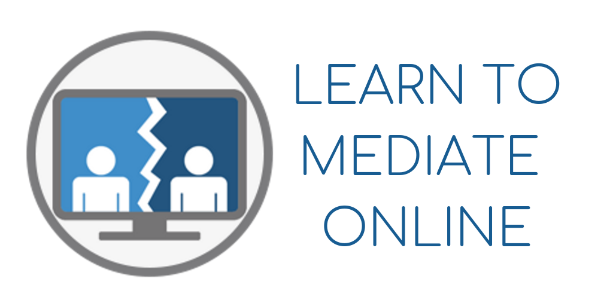
Susan
Guthrie
Online
Mediation
and
Coaching

Slide 3
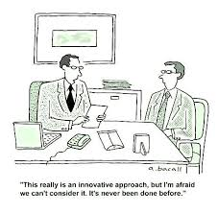
SCMA 31st Annual Conference Los Angeles, CA November 1-2, 2019
The Most Expensive
Words in Business:
“But that’s the way
we’ve always done it!”

Slide 4
SCMA 31st Annual Conference Los Angeles, CA November 1-2, 2019
Online
Mediation
Conducting a Mediation through the use of an online video conferencing program.
Participants are remote from the mediator and may be remote from each other.

Slide 5
SCMA 31st Annual Conference Los Angeles, CA November 1-2, 2019
Convenient
No travel
Can be anywhere (with some limits)
2. Expands Client Base
Clients need not be geographically close
3. Reduces Overhead
No rent, utilities. Programs are less than $100/mo.
4. More Comfortable and Supportive
Can be in a place of safety or comfort
5. Safer
Domestic violence or high conflict matters
6. Disability Compatible
Clients with disabilities
Benefits:

Slide 6
SCMA 31st Annual Conference Los Angeles, CA November 1-2, 2019
The #1 Difference Between
Online and
In-Person Mediation is:
The Client’s Environment is out of the Mediator’s Control
Can lead to issues with privacy and confidentiality
Cautions:

Slide 7
1. How to Conduct a Mediation on Zoom 2. Practical and Ethical Considerations

Slide 8
SCMA 31st Annual Conference Los Angeles, CA November 1-2, 2019
What an Online
Mediation Looks Like
Video Removed for file size.

Slide 9
SCMA 31st Annual Conference Los Angeles, CA November 1-2, 2019
Always use the waiting room function when having clients log on to the
Mediation session to avoid any issues or perceptions that neutrality has
Been breached.
Set up the meeting for the clients well in advance and let them know that they will both be in a “virtual waiting room” until they have both signed on to the session at which time, they will be admitted to the meeting simultaneously.
Let them know that this is to protect the process and to preserve neutrality.
Set a time limit for how long you will wait for both to enter the waiting room and/or have a protocol for communicating (email, text, phone)
A 5 or 10-minute window after which you will bring the party or parties who are present into the room to discuss solely how to proceed.
Meeting
Set Up
and
Waiting
Room

Slide 10
SCMA 31st Annual Conference Los Angeles, CA November 1-2, 2019
Caucus
and
Break Out
Rooms
Zoom easily allows for “muting” one or more parties so that there can be a private conversation.
Mute puts the non-participatory party or parties back in the “virtual waiting room”.
Depending on how many parties there are and whether the mediation is primarily joint session or separate, Breakout Rooms may be more practical.
Breakout Rooms can have more than one participant in them, such as a client and their attorney.
You can have as many Breakout Rooms as needed and the mediator can move between rooms and can move people into difference Breakout Rooms.

Slide 11
SCMA 31st Annual Conference Los Angeles, CA November 1-2, 2019
Screen
Sharing
Documents
Whiteboard,
and More
It is very easy to share your screen with the mediation participants. This allows everyone who is in the meeting to see whatever you bring up on your computer screen.
Examples: Agreements, financial documents, photographs, financial software, etc.
Participants can share their screen as well.
The Screen Sharing Function has a Whiteboard as well as the ability to share the screen of your iPad, cell phone or Tablet.

Slide 12
Practical and Ethical Considerations

Slide 13
SCMA 31st Annual Conference Los Angeles, CA November 1-2, 2019
I use a variety of online programs to streamline function of the mediation process that would normally take place in person:
The sharing and storing of documents. (Dropbox, Google Docs, etc.
The signing/execution of documents (Docusign, RightSignature, etc.
PAYMENT!! (Square, PayPal, Venmo)
IMPORTANT: Let clients know what programs you use, what requirements there are, and why you use them.
You Will
Need to Have
More Than
Video-Conferencing

Slide 14
SCMA 31st Annual Conference Los Angeles, CA November 1-2, 2019
#1 TIP:
Create a Document that
Educates and Informs
the Clients
Ex: My Online Guidelines & Ground Rules

Slide 15
SCMA 31st Annual Conference Los Angeles, CA November 1-2, 2019
Privacy
and
Confidentiality
Confidentiality:
Legal issue: Evidentiary Privilege. In California it is accorded by
the provisions of California Evidence Code 1115-1128.
Clients need to understand what the privilege means – explain this in writing.
Understand the Confidentiality provisions for mediation in your jurisdiction, if any.
Privacy:
Mediation Issue: One of the main benefits of the process.
Also one of the most vulnerable due to the fact that the clients are remote.
No third parties, no eavesdroppers, secure WiFi, NO RECORDING

Slide 16
SCMA 31st Annual Conference Los Angeles, CA November 1-2, 2019
Ground
Rules
Interruption Free Zone
Technology Hiatus
Early Log On
Respectful/Effective
Online Communication

Slide 17
SCMA 31st Annual Conference Los Angeles, CA November 1-2, 2019
The
LIFESAVER
HAVE SIMPLE PROTOCOLS IN
PLACE IN CASE OF TECH FAILURE
Let the clients know what to do if something goes wrong
with the technology, BECAUSE SOONER OR LATER IT WILL!
2. K.I.S.S.
Tell them to log back in or call you on a designated number
to discuss next steps.
Put this IN WRITING to the clients so that when it happens,
there is no panic.

Slide 18
SCMA 31st Annual Conference Los Angeles, CA November 1-2, 2019
FINAL
WORDS
First and foremost, add an online
platform to your practice.
Take the time to learn how to use
the programs
Stay calm if something goes wrong
Let people know you offer your
services online!

Slide 19
SCMA 31st Annual Conference Los Angeles, CA November 1-2, 2019
Susan Guthrie
LEARN TO MEDIATE ONLINE
www.learntomediateonline.com
susan@learntomediateonline.com
203-295-3388

