Slide 1
BECOMING AN MC3-CERTIFIED MEDIATOR
Dr. Jack R. Goetz, Esq. MC3 President, 2018 SCMA President
Jason Harper MC3 Board Member, 2017 SCMA President
Victoria Gray MC3 Secretary
SCMA CONFERENCE | NOVEMBER 2, 2019

Slide 2
Expanding the Use of Mediation
Dr. Jack R. Goetz, Esq.

Slide 3
We Are In The Other 60%
More than 40% of the United States workforce is subject to some sort of occupational regulation, which may include:
Registering with the government;
Completing a certain amount of education;
Passing an examination; and/or
Demonstrating a minimal degree of competency in an objective way.

Slide 4
Issues Many of Us Experience
Common comments heard as SCMA President:
We do not get the respect we deserve as mediators. I deserve as much respect as for my work as counsel as I am just as professional.
I am tired of everyone expecting us to give our services away for free.
Are these connected?
Common experience in small claims court and elsewhere:
Disputants cannot generally describe what a mediator does without being supplied an explanation. Yet, they can often describe what an accountant, attorney, nurse, or teacher does. Are these connected?

Slide 5
Hallmarks of formalized profession
Education—often linked to a degree.
Binding ethics code.
Self governing—weeding the non-quality practitioners out.
Continuing education—keeping current in the field.
If licensure, often a test.
Currently, mediation does not require any of the above, but other professions have all of the above that provide quality assurance to the public.
MC3’s proposition is that establishing more quality assurance in mediation will ultimately provide more respect for mediators as well as provide the public more information to pave the way for direct interaction.

Slide 6
Mediator Practice Standards
If we do not decide practice standards for ourselves, someone else will do it for us. (Steve Dinkin, National Conflict Resolution Center, San Diego, CA, 2006)
Mediation is growing up and needs to accept responsibilities of adulthood.
Consumers of mediation need protection; right to know how to find a quality mediator.
Sacred cow of mediator confidentiality remains at risk should we not develop methodology for quality assurance.

Slide 7
ABA Task Force Report (2012)
What should an effective credentialing program include?
MC3 Certification
Clearly define the skills, knowledge and values which persons it credentials must possess.
Ensure that candidates have training adequate to instill those skills, knowledge and values.
Be administered by an organization distinct from the organization which trains the candidate.

Slide 8
ABA Task Force Report (2012)
What should an effective credentialing program include?
MC3 Certification
Have an assessment process capable of determining with consistency whether candidates possess the defined skills, knowledge, and values.
Explain clearly to persons likely to rely on its credential what is being certified.
Provide an accessible, transparent system to register complaints against credentialed mediators. Promptly and fairly investigate complaints and, if appropriate, de-credential a mediator who fails to comply with standards.

Slide 9
ABA Task Force Report (2012)
What should an effective credentialing program NOT do?
MC3 Certification
Operate as mandatory licensing.
Bar non-lawyers from becoming credentialed.
Bar disputants from selecting a non-credentialed mediator.

Slide 10
Comparison of MC3 Certification to LASC 2018 RFP
Background Category | MC3 Certification | LASC 2018 RFP | Comparison
Mediator Education | Accepts diverse pool as there is no demonstrated correlation between J.D. degree and mediator skill. Mediators without law degrees will be required to complete a 3-hour litigation nuts and bolts program. | 10 years of active California Bar membership only. De facto rejection of ABA and ACR Task Forces that have studied mediator credentialing and have recommended diverse pools. | MC3 allows for a more diverse pool which is closer to the values represented by the field. MC3 more closely aligned with ACR and ABA Task Forces on this issue.

Slide 11
Comparison of MC3 Certification to LASC 2018 RFP
Background Category | MC3 Certification | LASC 2018 RFP | Comparison
Mediator Training | 80 hours of mediation training, some of which can be offset by completing degree programs. Requirement of 25 hours in comprehensive program is reflective of statewide standards under DRPA. | 40 hours of mediation training. Requirement of 32 hours in comprehensive program de facto excludes many DRPA-trained mediators. | MC3 requires more education and training, while not excluding DRPA-trained mediators.

Slide 12
Comparison of MC3 Certification to LASC 2018 RFP
Background Category | MC3 Certification | LASC 2018 RFP | Comparison
Mediation Practice | 50 hours of mediation experience. | 12 hours of mediation experience. | MC3 requires more mediation experience.
Continuing Mediator Training and Experience | 20 hours every 3 years; 1.5 hours must be in mediator ethics. | 7 hours every 2 years, at least 1 hour must in ethics. | MC3 requires more continuing training.
Quality Assurance | System modeled after the California Rules of Court in court-connected cases. | Left to the RFP provider. | MC3 has a quality assurance process that is based upon professional standards.

Slide 13
Comparison of MC3 Certification to LASC 2018 RFP
Background Category | MC3 Certification | LASC 2018 RFP | Comparison
Ethical Requirements | California Rules of Court. AAA/ABA/ACR Model Standards of Conduct for Mediators. Required completion of AOC 1.5-hour program on ethical rules for mediators contained in the California Rules of Court. | California Rules of Court. | Similar ethical requirements.

Slide 14
Raising the Bar
Formalized Profession
MC3 Certification
Education—often linked to a degree.
Binding ethics code.
Self-governing.
Continuing education—keeping current in the field.
If licensure, often a test.
80 hours of training and education (degrees count).
AAA/ABA/ACR & CRC.
Ethics complaint process.
Continuing professional education and activity.
Judicial Council ethics program.

Slide 15
MC3 Application Process
Jason Harper

Slide 16
MC3 Application Process
Qualifications Process
Two hundred (200) total points are required for initial certification by meeting all of the Components.
Education Component
Mediation Experience Component
Professional Activity and Continuing Professional Development Component
Forty (40) total points, as detailed in the Professional Activity and Continuing Professional Development Component, are required to maintain MC3 Certification every three (3) years.

Slide 17
Education Component
80 hours of mediation-specific training from organizations acceptable to MC3 (1-point for each hour of training) including:
American Arbitration Association
American Institute of Mediation
California State University at Dominguez Hills
Dispute Resolution Programs Act (DRPA) organizations that offer trainings of 25 hours or more in the basics of how to conduct a mediation
Mediate.com
Pepperdine University, Straus Institute
University of California at Los Angeles
University of Southern California Gould School of Law

Slide 18
Education Component
A minimum of 25 hours must be completed from one discrete program that covers the basics on how to conduct a mediation.
Credentials that could add to point total:
Post graduate degree in conflict resolution from a nationally or regionally accredited institution. (40 for degree/80 pts. for degree w/ mediation course)
First professional degree in law (J.D. or L.L.B.), or a Ph.D. in any discipline from a nationally or regionally accredited institution. (30 pts.)
Master’s degree from a nationally or regionally accredited institution. (25 pts.)
Bachelor’s degree from a nationally or regionally accredited institution. (20pts.)
Associate’s degree from a nationally or regionally accredited institution. (10 pts.)

Slide 19
Education component
Completion of the Distance Learning Course on Mediator Ethics offered by the Administrative Office of the Court will fulfill this requirement for 2019-2022 candidates. (30 pts.)

Slide 20
Education component
A minimum three hours litigation nuts-and-bolts training from a single training provider (the provider may be the same one used to complete the 25-hour requirement in 1, above, or it may be a different provider) whose curriculum includes legal terminology, litigation processes, rules and procedures. Candidates who have earned a J.D. or L.L.M. will be deemed to have met this requirement.
In order to be exempt from the litigation nuts and bolts training, you must show proof of performing at least 10 litigated-case mediations at the limited and unlimited jurisdiction level, not including civil harassment.

Slide 21
Mediation Experience Component
Proof of mediations (minimum 10 cases mediated or co-mediated, 1 point per hour mediated; ½ point per hour in co-mediation).
Minimum 30 points. Maximum 50 points.
Candidates must attach a list of cases and will be asked to provide detail on their role in the mediation, and the dates and length of time of those cases. Candidates will be required to affirm to the mediations under the penalty of perjury.

Slide 22
Mediation Experience Component
Mediation support and/or ancillary activities, acceptable to the MC3, with a mediator provider organization (1 point per 2 hours).
Such support roles may include, but are not limited to, mediation observations, case management, case intake or convening, facilitations, conciliations, mentoring, and peer mediation.
Candidates intending to qualify for the points available in this category will be required to submit a letter from their supervisor validating each role and experience.
Maximum of 20 points allowed.
Purely administrative tasks (clerical tasks where there is no direct contact with the mediator or the parties) will not qualify for points.

Slide 23
Professional activity Component
40 points required of all candidates.
Activities must have been completed in the 5 years immediately prior to applying for the initial certification.
This Component’s requirements must then be met every 3 years for continuing certification.

Slide 24
Professional activity Component
Training that enhances the practice of mediation from organizations acceptable to MC3, 1 point per hour.
Maximum of 20 points.
At least 3 of those points must come from attending mediation ethics programs.
Candidates may prove their education with certified transcripts, certificates, and/or other proof of training acceptable to the MC3.
Initial certification candidates may use training hours from the Education Component to satisfy this requirement provided the training was in the previous 5 years.

Slide 25
Professional activity Component
Membership in professional societies or organizations relevant to mediation.
Maximum of 10 points.
This category includes, but is not limited to, ADR sections of various bars and associations, SCMA, NAFCM, ACR, CDRC, etc. (5 points for each membership).

Slide 26
Professional activity Component
Published mediation articles or conference presentations relevant to mediation.
Maximum 10 points.
While not all articles or presentations may be accepted to satisfy this standard, training that is an enhancement on the core content enumerated in the Education Component would presumptively qualify.
5 points per article or conference presentation.

Slide 27
Professional activity Component
Awards for professional contributions to mediation or mediator accomplishments.
Maximum 10 points.
An award for participation in a program does not qualify.
5 points per award.

Slide 28
Professional activity Component
Teaching in university conflict resolution programs, law school ADR courses, and trainings recognized by MC3.
Maximum of 10 points.
5 points for each training.

Slide 29
Professional activity Component
Proof of mediations (minimum 10 cases mediated or co-mediated, 1 point per hour mediated; ½ point per hour in co-mediation).
Maximum 20 points.
Candidates must attach a list of cases and will be asked to provide detail on their role in the mediation, and the dates and length of time of those cases.
Candidates will be required to affirm to the mediations under the penalty of perjury.

Slide 30
Professional activity Component
Mediation support and/or ancillary activities, acceptable to the MC3, with a mediator provider organization (1 point per 2 hours).
Maximum of 20 points allowed.
Such support roles may include, but are not limited to, mediation observations, case management, case intake or convening, facilitations, conciliations, mentoring, and peer mediation.
Candidates intending to qualify for the points available in this category will be required to submit a letter from their supervisor validating each role and experience.
Initial certification candidates may use activities from the Performance Component to satisfy this requirement.

Slide 31
Elements for Qualifications
These are the baseline qualifications:
Education
80 hours of mediation training (25 hours from one discrete training program).
Performance
10 cases mediated.
Professional Activity
40 points total from various activities.
20 hours of training, including 3 hours of ethics.

Slide 32
Mc3-Certified Mediator Commitments
Dr. Jack R. Goetz, Esq.

Slide 33
Commitments
Each MC3-Certified Mediator agrees to abide by the policies and procedures that govern certification.
Among these commitments, MC3-Certified Mediators agree to include a paragraph in their mediation confidentiality agreements related to the MC3 Grievance Procedure.
An exception is made for DRPA mediations.

Slide 34
The Paragraph
As an MC3-Certified Mediator, mediator has agreed to abide by the Model Standards of Conduct for Mediators adopted by the American Arbitration Association, the American Bar Association, and the Association for Conflict Resolution and by the Standards of Conduct for Mediators in Court-Connected Mediation Programs adopted by the California Judicial Council. The Mediation Certification Consortium of California (MC3) has established a confidential Grievance Procedure for addressing any reports that an MC3-Certified Mediator has not appropriately followed applicable standards of conduct. The undersigned participants agree that any communications in the course of this mediation, including any that might otherwise be confidential or protected from disclosure based on mediation confidentiality, may be disclosed in an MC3 Grievance Proceeding, for the limited purpose of asserting, defending, investigating, and resolving a report that an MC3-Certified Mediator did not appropriately follow the applicable standards of conduct.

Slide 35
Why?
The MC3 Grievance Procedure enhances the credibility of the MC3-Certified Mediator designation.
It helps fulfill the expectations of those who rely on MC3 Certification when selecting a mediator.
It is an important way to help professionalize mediation.

Slide 36
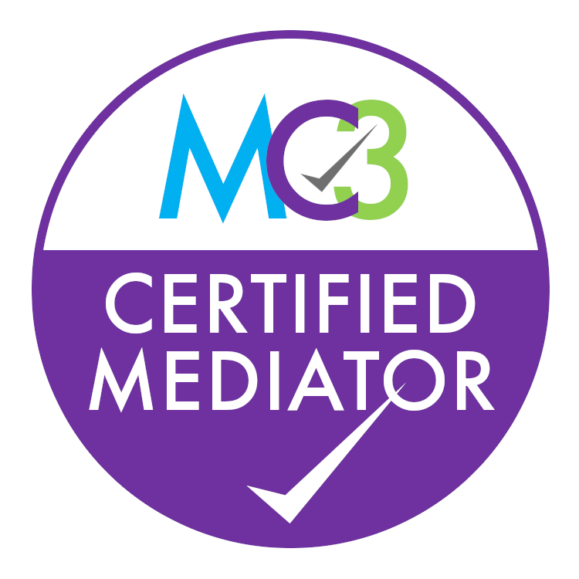
MC3 Certification Mark
Victoria Gray

Slide 37
Powerful Marketing tool
Helps increase acceptance of your mediation services.
Your clients and potential clients will be more inclined to trust literature, advertising, and promotional materials that bear the MC3 Certification Mark.
Helps build confidence and trust in your mediation services.
When your clients see the MC3 Certification Mark on your business card or in an advertisement, they will know that you have been evaluated by an unbiased third-party organization and have successfully met the requirements of the gold standard for mediator certification.

Slide 38
Powerful Marketing tool
Helps entry into new areas.
Whether it is a new industry segment or a new market, using the MC3 Certification Mark on your advertising and promotional materials will help make it easier to reach new clients.
Provides a fast communication tool.
The challenge for any mediator is to communicate her or his reliability and expertise quickly and effectively. The MC3 Certification Mark is one tool that does this quickly—it is a small mark with a giant message.

Slide 39
Powerful Marketing tool
Helps reduce marketing costs.
Credibility and confidence come faster with the MC3 Certification Mark, helping to reduce your marketing expenses.
Helps increase profitability.
The MC3 Certification Mark will help attract clients that want to use your services to mediate. But to obtain the maximum benefit, you should consistently use the MC3 Certification Mark to promote your services.

Slide 40
Where to use the MC3 Certification mark
Business cards.
Literature.
Websites.
Brochures.
Promotional Materials.
Mediation agreements.
Confidentiality agreements.
Catalogs.
Advertising.

Slide 41
Guidelines
The MC3 Certification Mark is property of MC3 and may only be used by an MC3-Certified Mediator while that mediator is in good standing.
Certain rules apply when using the mark. These rules help protect the value of the mark for all MC3-Certified Mediators.

Slide 42
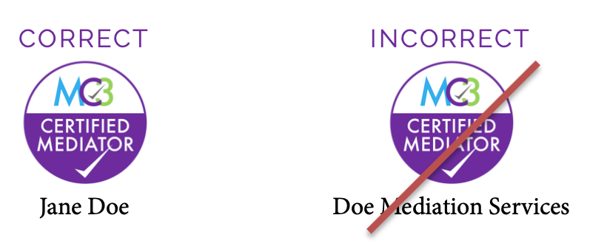
Rule 1
The MC3 Certification Mark must be displayed only in association with the certified mediator.
The mark must not be used in a way that suggests that a firm, uncertified mediators, or others are MC3 certified.
To avoid ambiguity, the MC3 Certification Mark must be used in close proximity to the name of the MC3-Certified Mediator.

Slide 43
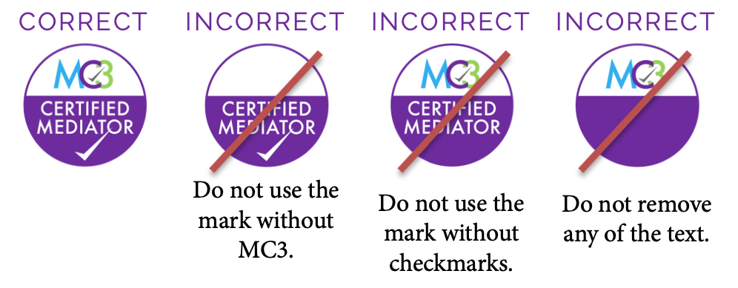
Rule 2
The MC3 Certification Mark must be displayed in its entirety to protect the visual integrity of the mark.
The MC3 Certification Mark should not be altered in any manner.
Individual elements of the mark should not be removed.

Slide 44
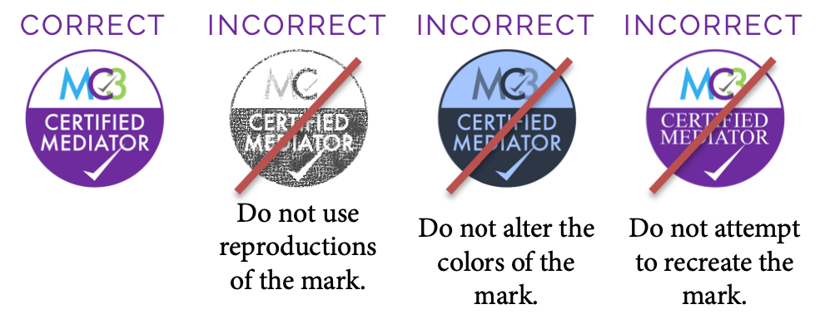
Rule 3
All copies of the mark must be made from original artwork provided by MC3.
The MC3 Certification Mark must not be altered, modified, or recreated.

Slide 45
Rule 4
Where possible, use MC3’s certification mark notice:
The Mediator Certification Consortium of California (MC3) is the owner of the MC3 Certification Mark. Authorized use of the MC3 Certification Mark signifies that the mediator has met the requirements for MC3 Certification and remains in good standing with MC3.

Slide 46
Rule 5
The MC3 Certification Mark must not be used in a disparaging manner.
The mark should not be used in any manner that would bring MC3 into disrepute or cause the public to lose trust in MC3 Certification.

Slide 47
Where can I obtain copies of the original artwork?
Downloadable copies of the MC3 Certification Mark are available in the Mediators Section of the MC3 website.
This section of the site is accessible only to MC3-Certified Mediators.

Slide 48
How can I be sure if I’m using the mark correctly?
Review the MC3 Certification Mark Usage Guide available on the Mediators Section of the MC3 website.
Contact support@mc3certified.org if you have specific questions.

Slide 49
Why is this such a big deal?
MC3 must take appropriate measures to ensure the MC3 Certification Mark is properly used or it could lose its rights in the mark.
If this were to happen, MC3 might be unable to prevent uncertified mediators from using the MC3 Certification Mark, which could confuse the public and dilute the value of MC3 Certification for MC3-Certified Mediators.

Slide 50
What happens if I break the rules?
MC3 expects that MC3-Certified Mediators will make every effort to comply with these rules because protecting the MC3 Certification Mark protects the value of MC3 Certification.
If an MC3-Certified Mediator chooses not to follow the rules, the mediator could be subject to MC3’s disciplinary process.

Slide 51
Next Steps
If you are interested in applying for MC3 certification, you can visit our website: https://www.mc3certified.org
Attend the SCMA Program on Litigation Nuts and Bolts:
When: November 16, 2019 from 9am-Noon
Where: USC Gould School of Law, Room 130
Register: SCMA Website

